Slide 1
Lecture 13, still lesson 8:Simple harmonic motion
Teacher: Dr. Paul Briard

Slide 2




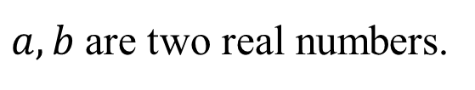
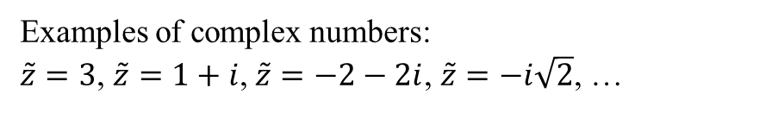
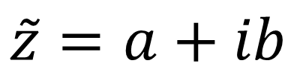

Complex numbers
The imaginary unit: $i$
$$i^{2}=−1$$
(symbol “j” is also used for the imaginary unit)
A complex number $\tilde{z}$ has two kinds of forms:
1st form:
$$\tilde{z}=a+ib$$
$a,b$are two real numbers.
$$a=ℛℯ\left\{\tilde{z}\right\}$$
$a$ is the real part of the complex number $\tilde{z}$
$$b=ℐ𝓂\left\{\tilde{z}\right\}$$
$b$ is the imaginary part of the complex number $\tilde{z}$
Examples of complex numbers:
$\tilde{z}=3$, $\tilde{z}=1+i$, $\tilde{z}=−2−2i$, $\tilde{z}=−i\sqrt{2}$, …

Slide 3



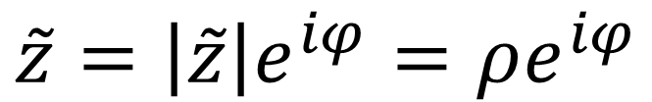






Complex numbers
2nd form (named polar form)
$$\tilde{z}=\left|\tilde{z}\right|e^{iφ}=ρe^{iφ}$$
$$ρ=\left|\tilde{z}\right|$$
$ρ$ is the modulus of the complex number $\tilde{z}$
$$φ=arg⁡(\tilde{z})$$
The angle $φ$ is the argument of the complex number $\tilde{z}$
$$Im$$
axis of the imaginary part
$$b$$
$$\tilde{z}=a+ib=ρe^{iφ}$$
$$ρ$$
axis of the real part
$$φ$$
$$a$$
$$ℛe$$

Slide 4






Complex numbers
Relationship between both forms of the complex number:
$$e^{iφ}=\cos{φ}+i\sin{φ}$$
$$\tilde{z}=ρe^{iφ}=ρ\cos{φ}+iρsin{φ}$$
$$a= ρ\cos{φ}$$
$$ρ=\sqrt{a^{2}+b^{2}}$$
$$b= ρ\sin{φ}$$
$$\tan{φ}=\frac{b}{a}$$
$$Im$$
axis of the imaginary part
$$b$$
$$\tilde{z}=a+ib=ρe^{iφ}$$
$$ρ$$
axis of the real part
$$φ$$
$$a$$
$$ℛe$$

Slide 5
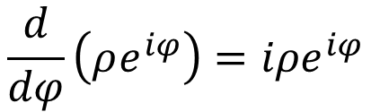
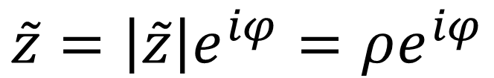

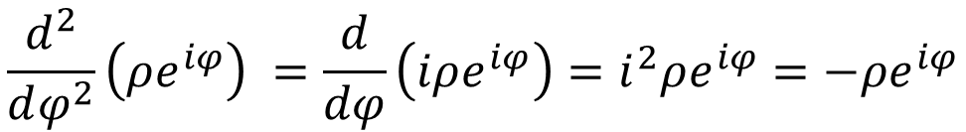
Complex numbers
$$\tilde{z}=\left|\tilde{z}\right|e^{iφ}=ρe^{iφ}$$
$$\frac{d}{dφ}\left(ρe^{iφ}\right)=iρe^{iφ}$$
$$\frac{d^{2}}{dφ^{2}}\left(ρe^{iφ}\right) =\frac{d}{dφ}\left(iρe^{iφ}\right)=i^{2}ρe^{iφ}=−ρe^{iφ}$$
$$i^{2}=−1$$
Complex numbers are very useful to describe physical phenomena based on the solution of differential equations, such as the SHM.

Slide 6
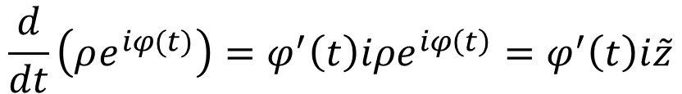
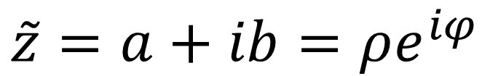
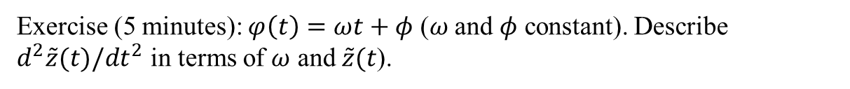

Complex numbers
$$\tilde{z}=a+ib=ρe^{iφ}$$
If $φ$depends on the time t and $ρ$ is constant,
$$\frac{d}{dt}\left(ρe^{iφ(t)}\right)=φ^{′}\left(t\right)iρe^{iφ\left(t\right)}=φ^{′}\left(t\right)i\tilde{z}$$
$$φ^{′}\left(t\right)=\frac{dφ(t)}{dt}$$
Exercise (5 minutes): $φ\left(t\right)=ωt+φ$ ($ω$ and $φ$ constant). Describe $d^{2}\tilde{z}(t)/dt^{2}$ in terms of $ω$ and $\tilde{z}(t$).

Slide 7
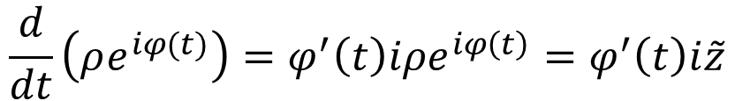



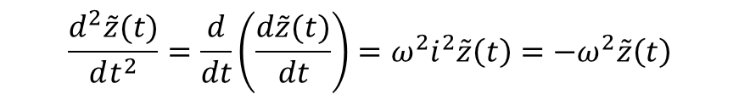

Complex numbers
$$\frac{d}{dt}\left(ρe^{iφ(t)}\right)=φ^{′}\left(t\right)iρe^{iφ\left(t\right)}=φ^{′}\left(t\right)i\tilde{z}$$
$$φ\left(t\right)=ωt+φ$$
$$φ^{′}\left(t\right)=\frac{dφ(t)}{dt}=ω$$
$$\frac{d\tilde{z}(t)}{dt}=ωiρe^{iφ(t)}=ωi\tilde{z}(t)$$
$$\tilde{z}=ρe^{i(ωt+φ)}$$
$$\frac{d^{2}\tilde{z}(t)}{dt^{2}}=\frac{d}{dt}\left(\frac{d\tilde{z}(t)}{dt}\right)=ω^{2}i^{2}\tilde{z}\left(t\right)=−ω^{2}\tilde{z}\left(t\right)$$
$$\frac{d^{2}\tilde{z}(t)}{dt^{2}}=−ω^{2}\tilde{z}\left(t\right)$$
Maybe this reminds you something.

Slide 8
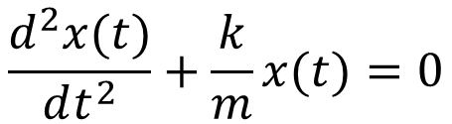

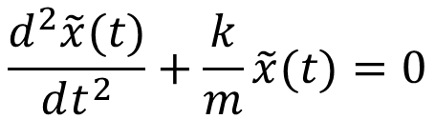
About solving 2nd degree differential equation
$$\frac{d^{2}x(t)}{dt^{2}}+\frac{k}{m}x(t)=0$$
Here is an easy way to solve them, however, this way is not easy to understand … If it is not clear now, it doesn’t matter, it will come with practice.
We use that “if two complex numbers are equal, then their real parts are equal”
$x$ (the displacement in our case) is a real number. You set, “$x$ is the real part of the complex number $\tilde{x}$”, which respect the equation:
$$\frac{d^{2}\tilde{x}(t)}{dt^{2}}+\frac{k}{m}\tilde{x}(t)=0$$
The solution of such equation has the form:
$$\tilde{x}(t)=Ae^{i(ωt+φ)}$$
which is very easy to derivate.

Slide 9
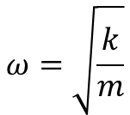
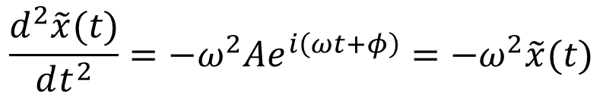

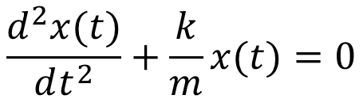


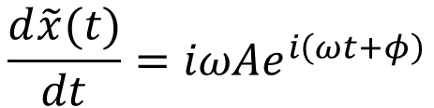
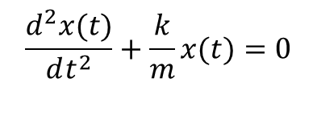
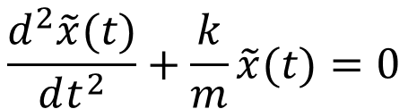
About solving 2nd degree differential equation
$$\frac{d^{2}x(t)}{dt^{2}}+\frac{k}{m}x(t)=0$$
$$\frac{d^{2}\tilde{x}(t)}{dt^{2}}+\frac{k}{m}\tilde{x}(t)=0$$
$$\tilde{x}(t)=Ae^{i(ωt+φ)}$$
$$\frac{d\tilde{x}(t)}{dt}=iωAe^{i\left(ωt+φ\right)}$$
$$\frac{d^{2}\tilde{x}(t)}{dt^{2}}=−ω^{2}Ae^{i\left(ωt+φ\right)}=−ω^{2}\tilde{x}(t)$$
$$\frac{d^{2}x(t)}{dt^{2}}+\frac{k}{m}x(t)=0$$
The solution of
is the real part of $\tilde{x}(t)$
$$ω=\sqrt{\frac{k}{m}}$$
$$x\left(t\right)=A\cos\left(ωt+φ\right)$$
where

Slide 10


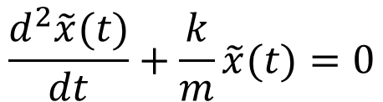
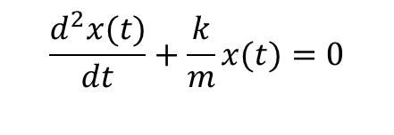
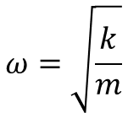

About solving 2nd degree differential equation: Summary
We use that “if two complex numbers are equal, then their real parts are equal”
$x$ (the displacement in our case) is a real number. You set, “$x$ is the real part of the complex number $\tilde{x}$”, which respect the equation:
$$\frac{d^{2}\tilde{x}(t)}{dt}+\frac{k}{m}\tilde{x}(t)=0$$
$$\frac{d^{2}x(t)}{dt}+\frac{k}{m}x(t)=0$$
The solution of
is the real part of $\tilde{x}(t)$
$$ω=\sqrt{\frac{k}{m}}$$
$$\tilde{x}(t)=Ae^{i(ωt+φ)}$$
$$x\left(t\right)=A\cos\left(ωt+φ\right)$$
where
This way can be extended to more complicated differential equations (not all of them, of course), as you will see later. Interest: it is often much more easy to derivate the exponential function. Difficulty is to understand that there could be a complex number associated with something as the displacement which is a real number …

Slide 11
End of the lesson 8

Slide 12
Lesson 9: Damped and driven oscillations
Teacher: Dr. Paul Briard

Slide 13
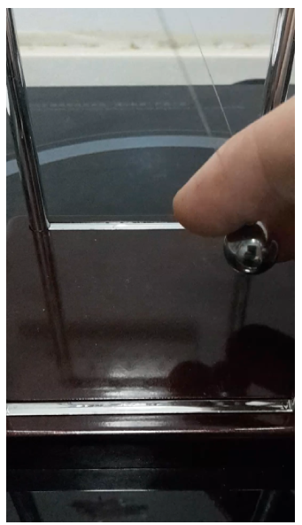
Introduction to damped oscillations: real pendulum: Pendulum with friction
Even if there is friction, the pendulum oscillates around the equilibrium positon
The oscillations are damped

Slide 14

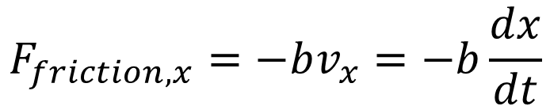


Damped oscillations
The oscillations discussed previously were without friction. Now, we consider that a friction is exerted on the body studied.
Its direction is opposite to the direction of velocity vector. We consider its magnitude is proportional to velocity (but the friction force can have other expressions).
$$F_{friction,x}=−bv_{x}=−b\frac{dx}{dt}$$
$${\vec{F}}_{friction}$$
$$\vec{v}$$
$$x$$

Slide 15





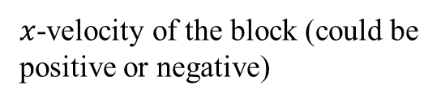

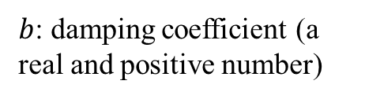


Damped oscillations
$$\vec{n}$$
$${\vec{F}}_{spring}$$
$$\vec{v}$$
$${\vec{F}}_{friction}$$
$$x$$
$$x=0$$
$$\vec{w}$$
$$F_{friction,x}=−bv_{x}$$
$b$: damping coefficient (a real and positive number)
$x$-velocity of the block (could be positive or negative)

Slide 16



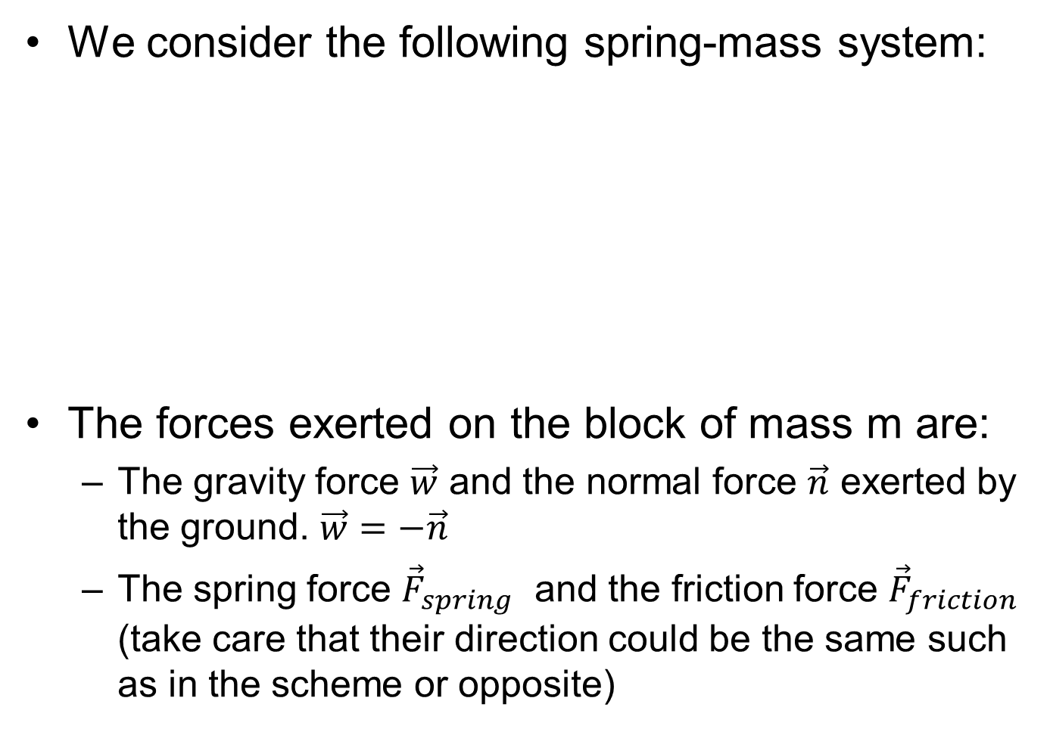




Damped oscillations
We consider the following spring-mass system:
The forces exerted on the block of mass m are:
The gravity force $\vec{w}$ and the normal force $\vec{n}$ exerted by the ground. $\vec{w}=−\vec{n}$
The spring force ${\vec{F}}_{spring}$ and the friction force ${\vec{F}}_{friction}$ (take care that their direction could be the same such as in the scheme or opposite)
$$\vec{n}$$
$${\vec{F}}_{spring}$$
$$\vec{v}$$
$${\vec{F}}_{friction}$$
$$x$$
$$x=0$$
$$\vec{w}$$
16

Slide 17
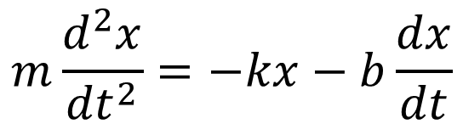
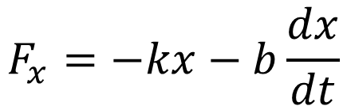
Damped oscillations
The x-component of the net force exerted on the body, included friction is then:
The Newton’s 2nd law gives:
$$F_{x}=−kx−b\frac{dx}{dt}$$
$$m\frac{d^{2}x}{{dt}^{2}}=−kx−b\frac{dx}{dt}$$

Slide 18
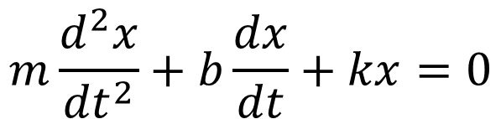
Damped oscillations
$$\vec{n}$$
$${\vec{F}}_{spring}$$
$$\vec{v}$$
$${\vec{F}}_{friction}$$
$$x$$
$$x=0$$
$$\vec{w}$$
Using the 2nd Newton’s law, we obtain:
$$m\frac{d^{2}x}{{dt}^{2}}+b\frac{dx}{dt}+kx=0$$
mass of the block
Damping coefficient
Spring coefficient

Slide 19

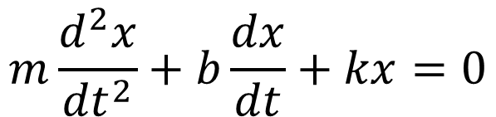
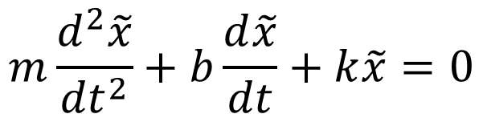
Damped oscillations
$$m\frac{d^{2}x}{{dt}^{2}}+b\frac{dx}{dt}+kx=0$$
An “easy” way to solve such equations is to use the following statement “If two complex numbers are equal then their real parts are equal”.
Step 1:
We consider the complex number $\tilde{x}$which $x$ is the real part. The complex number $\tilde{x}$verifies:
$$m\frac{d^{2}\tilde{x}}{{dt}^{2}}+b\frac{d\tilde{x}}{dt}+k\tilde{x}=0$$
Step 2:
We find $\tilde{x}(t)$, the solution of this equation.
Step 3:
The displacement $x(t)$ is obtained from
$$x\left(t\right)=Re\left\{\tilde{x}(t)\right\}$$
Interest of this way of solving: the exponential fonction is easy to derivate.
Difficulty is to imagine there could be a complex number associated with a displacement, something which is a real number.

Slide 20
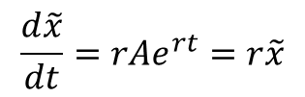

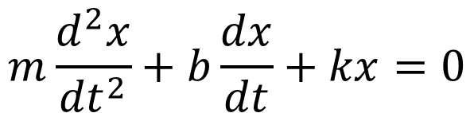



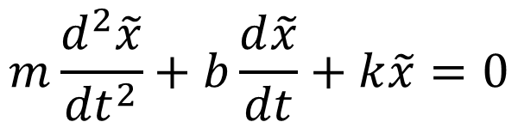
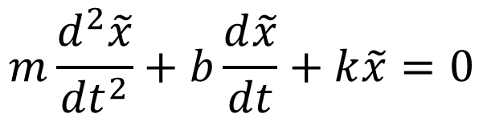
Damped oscillations
$$m\frac{d^{2}x}{{dt}^{2}}+b\frac{dx}{dt}+kx=0$$
We consider the complex number $\tilde{x}$which $x$ is the real part. The complex number $\tilde{x}$verifies:
$$m\frac{d^{2}\tilde{x}}{{dt}^{2}}+b\frac{d\tilde{x}}{dt}+k\tilde{x}=0$$
The solutions $\tilde{x}$ have the form (r can be complex or purely real):
$$\tilde{x}(t)=Ae^{rt}$$
$$\frac{d^{2}\tilde{x}}{{dt}^{2}}=r^{2}Ae^{rt}=r^{2}\tilde{x}$$
$$\frac{d\tilde{x}}{dt}=rAe^{rt}=r\tilde{x}$$
$$m\frac{d^{2}\tilde{x}}{{dt}^{2}}+b\frac{d\tilde{x}}{dt}+k\tilde{x}=0$$
$$mr^{2}+br+k=0$$
We have to solve this equation to describe $r$

Slide 21





Critical damping
$$mr^{2}+br+k=0$$
(Eq. 1)
$$∆=b^{2}−4mk$$
Depending to the values of b, m and k there are three possibilities:
Case 1
$$∆=0:$$
$$r_{0}=−\frac{b}{2m}$$
or
The root of Equation Eq. 1 is real:
$$b=2\sqrt{mk}$$
Case of critical damping
The system returns to equilibrium position without oscillation

Slide 22






Overdamping
$$mr^{2}+br+k=0$$
(Eq. 1)
$$∆=b^{2}−4mk$$
Depending to the values of b, m and k there are three possibilities:
Case 2
$$∆>0:$$
The roots of Equation Eq. 1 are reals
or
$$r_{1}=\frac{−b−\sqrt{∆}}{2m}$$
$$r_{2}=\frac{−b+\sqrt{∆}}{2m}$$
$$b>2\sqrt{mk}$$
Case of overdamping
Then $\tilde{x}$is purely real and
$$x=A_{1}e^{r_{1}t}+A_{2}e^{r_{2}t}$$
The system returns to equilibrium without oscillation (more slowly than for critical damping)

Slide 23
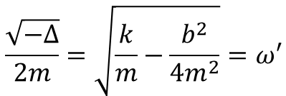








Damped oscillations
Third case:
$$∆<0:$$
The roots of Equation Eq. 1 are complex
or
$$r_{1}=\frac{−b−i\sqrt{−∆}}{2m}$$
$$r_{2}=\frac{−b+i\sqrt{−∆}}{2m}$$
$$b<2\sqrt{mk}$$
$$\frac{\sqrt{−∆}}{2m}=\sqrt{\frac{k}{m}−\frac{b^{2}}{4m^{2}}}=ω′$$
The complex solution of the differential equation is:
$$\tilde{x}=A_{1}e^{r_{1}t}+A_{2}e^{r_{2}t}$$
Which the displacement from equilibrium is the real part of $\tilde{x}$and has the form:
$$x(t)=e^{−\frac{b}{2m}t}\left(a_{1}\text{cos} ω^{′}t+a_{2}\sin{ω^{′}t} \right)$$
Another form of $x$ is:
$$x=Ae^{−\frac{b}{2m}t}\cos\left(ω^{′}t+φ\right)$$
This condition is called underdamping
The system returns to equilibrium with oscillation of angular frequency $ω′$

Slide 24
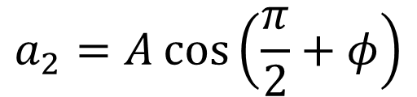





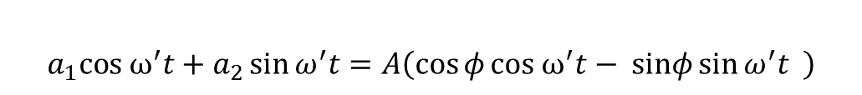


Damped oscillations
About the different forms of solution $x$:
$$x(t)=e^{− \frac{b}{2m}t}\left(a_{1}\text{cos} ω^{′}t+a_{2}\sin{ω^{′}t} \right)$$
$$x(t)=Ae^{− \frac{b}{2m}t}\cos\left(ω^{′}t+φ\right)$$
$$t=0$$
$$a_{1}=A\cos{φ}$$
$$t′=\frac{π}{2ω′}$$
$$a_{2}=A\cos\left(\frac{π}{2}+φ\right)$$
$$a_{2}=−A\sin{φ}$$
$$a_{1}\text{cos} ω^{′}t+a_{2}\sin{ω^{′}t}=A\cos{φ}\text{cos} ω^{′}t−A sinφ\sin{ω^{′}t}$$
$$a_{1}\text{cos} ω^{′}t+a_{2}\sin{ω^{′}t}=A\left(\cos{φ}\text{cos} ω^{′}t− sinφ\sin{ω^{′}t} \right)$$
$$a_{1}\text{cos} ω^{′}t+a_{2}\sin{ω^{′}t}=A\cos\left(ω′t+φ\right)$$
You don’t have to remember this demonstration. I give it for information.

Slide 25
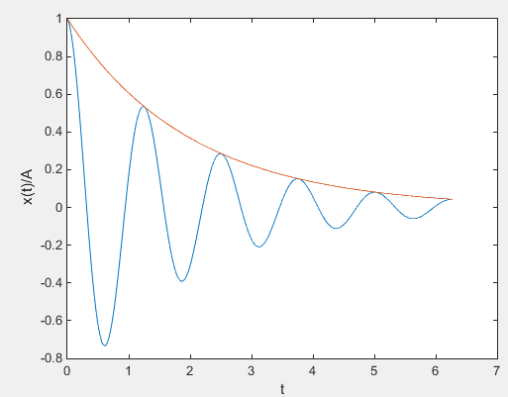






Damped oscillations
$$(s)$$
$$x(t)/A=e^{− \frac{b}{2m}t}\cos\left(ω^{′}t+φ\right)$$
$$φ=0 rad$$
Blue curve:
with
$ω^{′}=5 rad/s$ (time unit is s)
Red curve
$$f(t)=e^{− \frac{b}{2m}t}$$
$\frac{b}{2m}=0.5$ $s^{−1}$

Slide 26




Damping ratio
$$b=2\sqrt{mk}$$
Critical damping
$$ζ=1$$
$$b<2\sqrt{mk}$$
Underdamping
$$ζ<1$$
$$b>2\sqrt{mk}$$
Overdamping
$$ζ>1$$
We can define a damping ratio:
$$ζ=\frac{b}{2\sqrt{mk}}$$
(The symbol name is zeta)

Slide 27
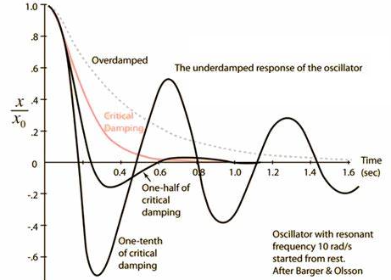








Summary
Overdamping:
$$x(t)=A_{1}e^{r_{1}t}+A_{2}e^{r_{2}t}$$
$$r_{1}=\frac{−b−\sqrt{∆}}{2m}$$
$$r_{2}=\frac{−b+\sqrt{∆}}{2m}$$
($r_{1}$ and $r_{2}$ are real numbers)
Critical damping:
$$x(t)=\left(A_{0}+B_{0}t\right)e^{r_{0}t}$$
$$r_{0}=−\frac{b}{2m}$$
($r_{0}$ is real number)
Underdamping:
$$x(t)=Ae^{− \frac{b}{2m}t}\cos\left(ω^{′}t+φ\right)$$
$A_{1},A_{2}$, $A_{0}$, $B_{0}$ $A$ are constants (they depends on the initial conditions of displacement and velocity )

Slide 28
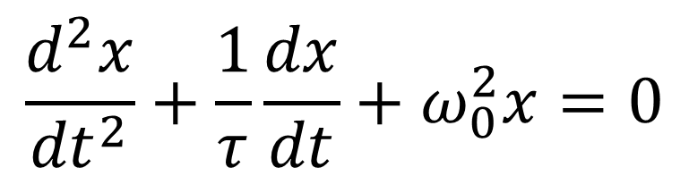



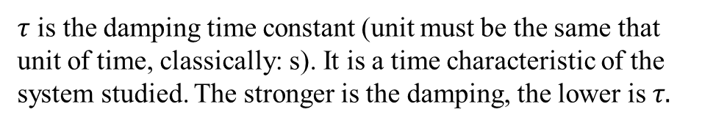
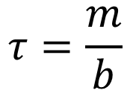
Another convenient form of equation $m\frac{d^{2}x}{{dt}^{2}}+b\frac{dx}{dt}+kx=0$ is:
This form is about damped oscillations of a spring-mass system.
But this form can describe of damped oscillations of other kinds of systems
$$\frac{d^{2}x}{{dt}^{2}}+\frac{1}{τ}\frac{dx}{dt}+ω_{0}^{2}x=0$$
$$e^{−\frac{b}{2m}t}$$
$$e^{−\frac{t}{2τ}}$$
$$τ=\frac{m}{b}$$
$τ$ is the damping time constant (unit must be the same that unit of time, classically: s). It is a time characteristic of the system studied. The stronger is the damping, the lower is $τ$

Slide 29
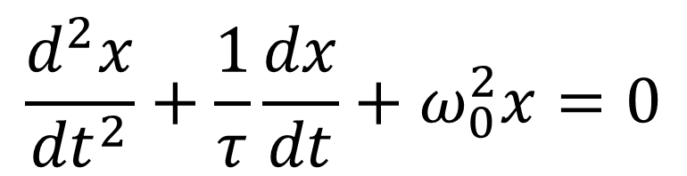




Another convenient form of equation $m\frac{d^{2}x}{{dt}^{2}}+b\frac{dx}{dt}+kx=0$ is:
$$\frac{d^{2}x}{{dt}^{2}}+\frac{1}{τ}\frac{dx}{dt}+ω_{0}^{2}x=0$$
For the spring-mass system:
$$ω_{0}=\sqrt{\frac{k}{m}}$$
$ω_{0}$ is the natural angular frequency of the system, i.e. the angular frequency of oscillation if the oscillations are not damped (which means if there is no friction )
The expression of $ω_{0}$ depends to the system studied (here it is $\sqrt{\frac{k}{m}}$ where k is the spring constant because we study a spring-mass system)

Slide 30




Relation between damped oscillations and simple harmonic motion
Damped oscillations:
$$x\left(t\right)=Ae^{− \frac{b}{2m}t}\cos\left(ω^{′}t+φ\right)=Ae^{− \frac{t}{2τ}}\cos\left(ω^{′}t+φ\right)$$
Solution of:
$$\frac{d^{2}x}{{dt}^{2}}+\frac{1}{τ}\frac{dx}{dt}+ω_{0}^{2}x=0$$
Simple harmonic motion
$$x\left(t\right)=A\cos\left(ω_{0}t+φ\right)$$
$$\frac{d^{2}x}{{dt}^{2}}+ω_{0}^{2}x=0$$
Solution of:
When
$τ=\frac{m}{b}→∞$, i.e. $b→0$ (frictionless motion)
The overdamped motion become an SHM

Slide 31



Relation between damped oscillations and simple harmonic motion
Damped oscillations:
Angular frequency of the damped oscillations:
$$ω^{′}=\sqrt{\frac{k}{m}−\frac{b^{2}}{4m^{2}}}≠\sqrt{\frac{k}{m}}$$
But for $b→0$,
$$ω^{′}→\sqrt{\frac{k}{m}}$$
This corresponds to the angular frequency of the SHM.

Slide 32








Mechanical energy in damped oscillations
The total mechanical energy is constant if only conservative forces does work on the body in motion
The friction force is a non-conservative force.
The total mechanic energy decrease during damped oscillations.
Exercise (5 minutes): Describe the change rate of mechanical energy $dE_{m}/dt$ in respect with the $x$-velocity during the damped oscillations (spring-mass system in horizontal motion). What can you say about the power of the friction force ?
$$\vec{n}$$
$${\vec{F}}_{spring}$$
$$\vec{v}$$
$${\vec{F}}_{friction}$$
$$x$$
$$x=0$$
$$\vec{w}$$

Slide 33







Mechanical energy in damped oscillations
As for the case of the SHM, where the osccilations are not damped, the expression of the total mechanical energy is:
$$E_{m}=E_{p}+E_{k}=\frac{1}{2}kx^{2}+\frac{1}{2}mv_{x}^{2}$$
$$\frac{dE_{m}}{dt}=\frac{d}{dt}\left(\frac{1}{2}kx^{2}\right)+\frac{d}{dt}\left(\frac{1}{2}mv_{x}^{2}\right)$$
$$\frac{dE_{m}}{dt}=kx\frac{dx}{dt}+mv_{x}\frac{dv_{x}}{dt}$$
$$\frac{dE_{m}}{dt}=kxv_{x}+mv_{x}\frac{d^{2}x}{dt}=v_{x}\left(kx+m\frac{d^{2}x}{dt}\right)$$
and
$$m\frac{d^{2}x}{dt^{2}}+b\frac{dx}{dt}+kx=0$$
$$m\frac{d^{2}x}{dt^{2}}+kx=−b\frac{dx}{dt}$$
$$\frac{dE_{m}}{dt}=−bv_{x}^{2}$$

Slide 34






Mechanical energy in damped oscillations
$$\frac{dE_{m}}{dt}=−bv_{x}^{2}$$
$$\frac{dE_{m}}{dt}<0$$
The total mechanical energy decrease with the time, because of the damping.
If $b→0$,
$\frac{dE_{m}}{dt}→0$, which correspond to the simple harmonic motion (no friction, mechanical energy is constant)
$$\frac{dE_{m}}{dt}=−bv_{x}.v_{x}=F_{friction,x}.v_{x}$$
We have seen that the power involved with a force $\vec{F}$ exerted on a body at velocity $\vec{v}$ is: $P=\vec{F}.\vec{v}$
$${\vec{F}}_{friction}.\vec{v}=F_{friction,x}v_{x}$$
Here:
The change rate of the mechanical energy is the power of the friction force.

Slide 35
End of lecture 13

